Slide 1
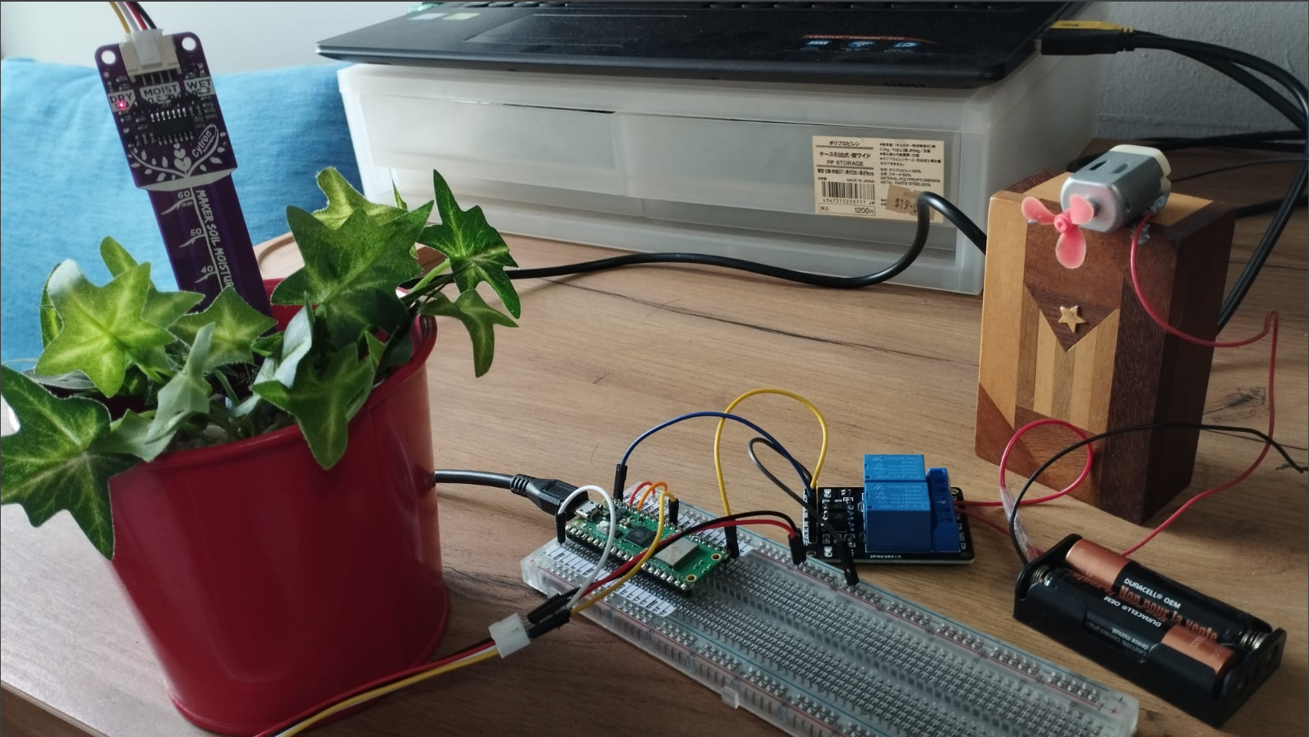
SIMULATION OF AUTOMATED PLANT WATERING SYSTEM
PUMP
EXTERNAL
POWER
SOURCE

Slide 2
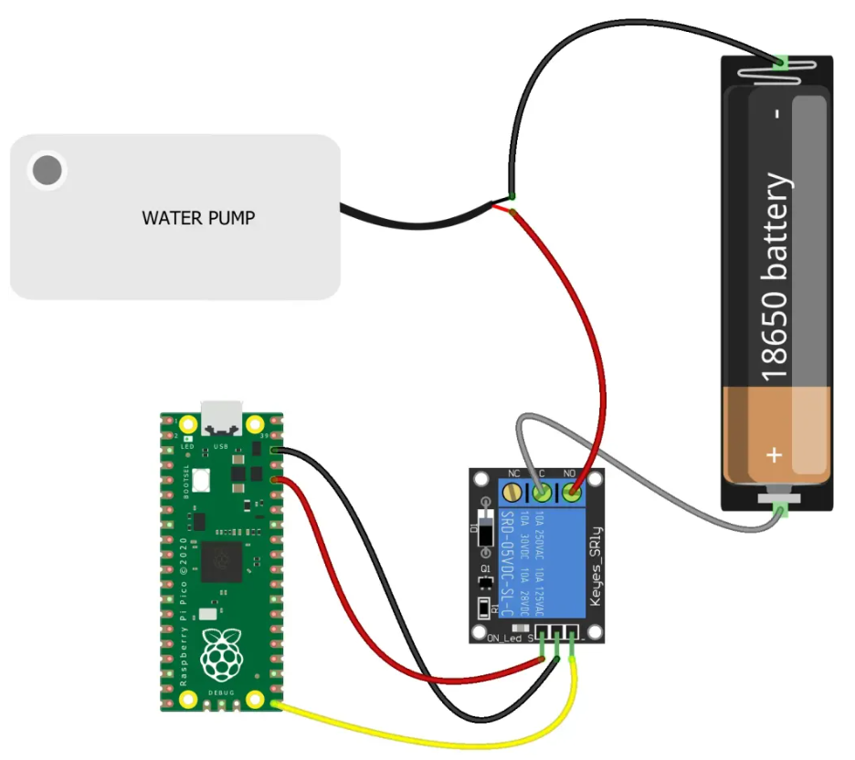
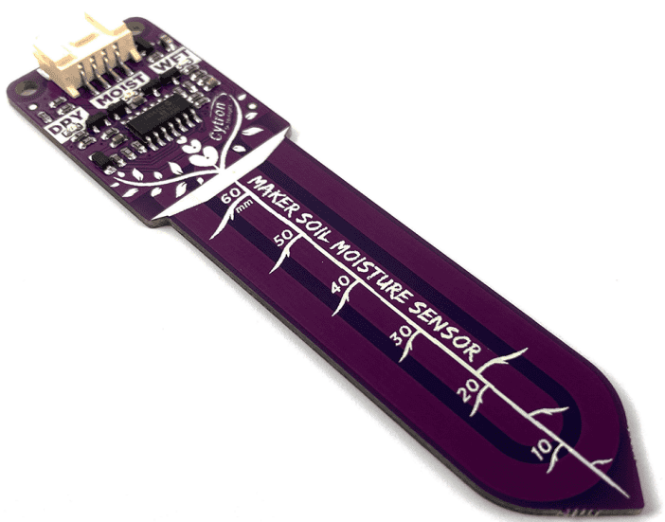
SIMULATION OF AUTOMATED PLANT WATERING SYSTEM
NO1
COM1
OUT -> GPIO26 (ADC0)
DIS -> GPIO 0
VCC -> VBU
GND

Slide 3
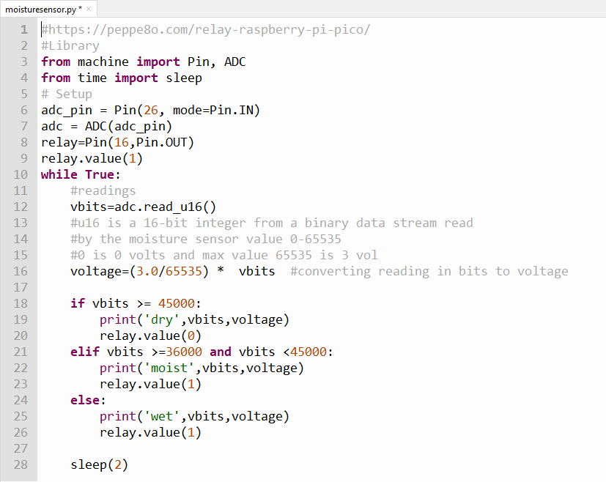
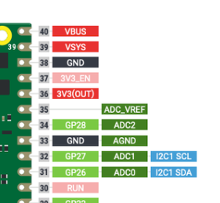
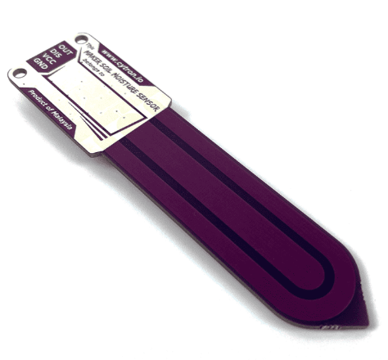
SAMPLE CODE
OUT to GPIO26
GPIO26 is one
Of several ADC
(Analog Digital
Converter)
You may need to tweak
the readings for
Dry, Moist and Wet

Slide 4
Explaining Computers
Plant Watering System
https://www.youtube.com/watch?v=_NTW0npN4N0
This is done using a Raspberry Pi. But the idea is still the same

Slide 5
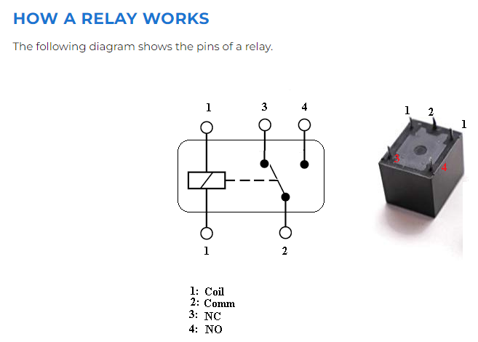
A NORMALLY OPENED (NO) CONNECTION
NC
NO
relay.value(1)
relay.value(0)
NO circuit is closed when
relay.value(0)

